Slide 1
SW 프로그래밍
20171105 이민욱

Slide 2
Focus
The Degree of Accuracy
Scale Issue (Memory & Speed)

Slide 3
Get FileList
Pattern Search
Ranking
Sorting

Slide 4
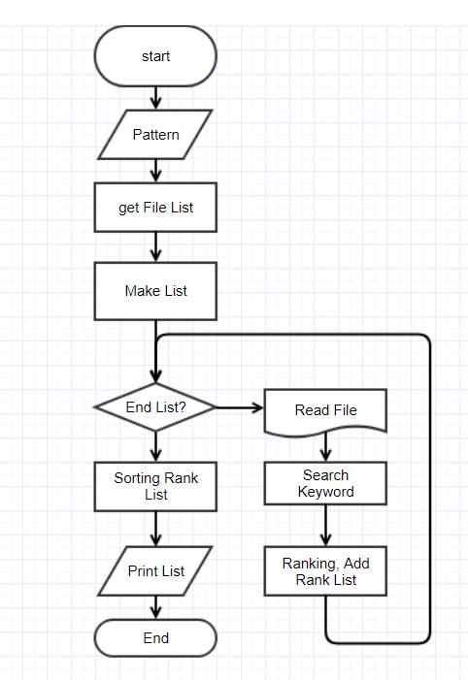
Flow Chart

Slide 5
Get File List
io.h
long _findfirst(char *filespec, struct _findata_at *fileinfo);
int _findnect(long handle, struct _finddata_t *fileinfo);
int _findclose(long handle);

Slide 6
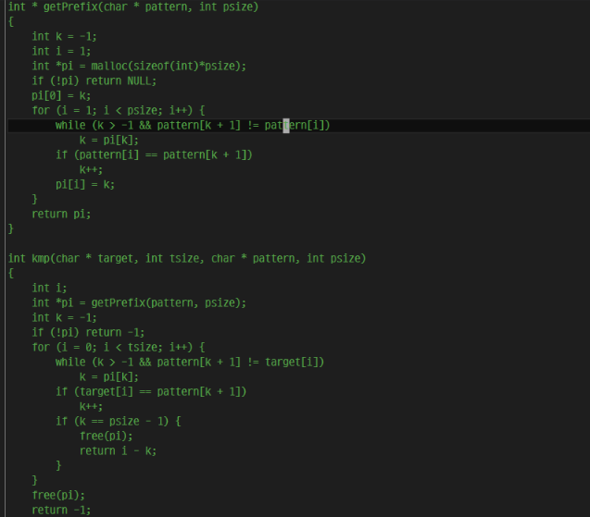

Pattern Search
string.h
const char * strstr ( const char * str1, const char * str2 );
strstr function principle : kmp + $α$
kmp algorithm
Save char* data in LinkedList (because of convenience of ranking)

Slide 7
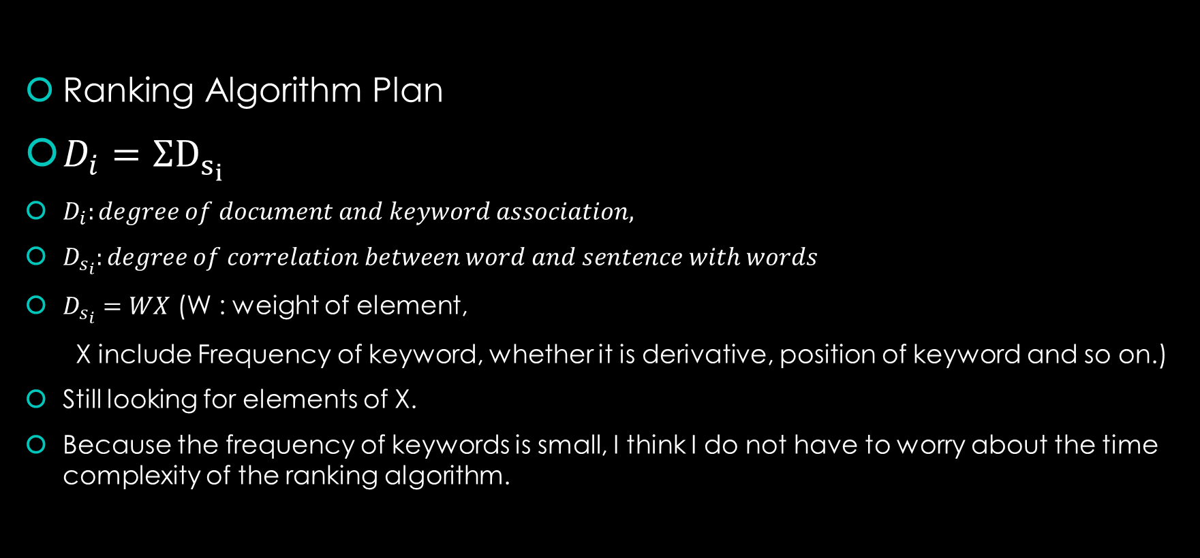
Ranking (The Degree of Accuracy)
Ranking Algorithm Plan
$D_{i}=ΣD_{s_{i}}$
$D_{i}:degree of document and keyword association,$
$D_{s_{i}}:degree of correlation between word and sentence with words$
$D_{s_{i}}=WX$ (W : weight of element,
X include Frequency of keyword, whether it is derivative, position of keyword and so on.)
Still looking for elements of X.
Because the frequency of keywords is small, I think I do not have to worry about the time complexity of the ranking algorithm.

Slide 8
Sorting
Because of Linked List, I use merge sort algorithm.

Slide 9
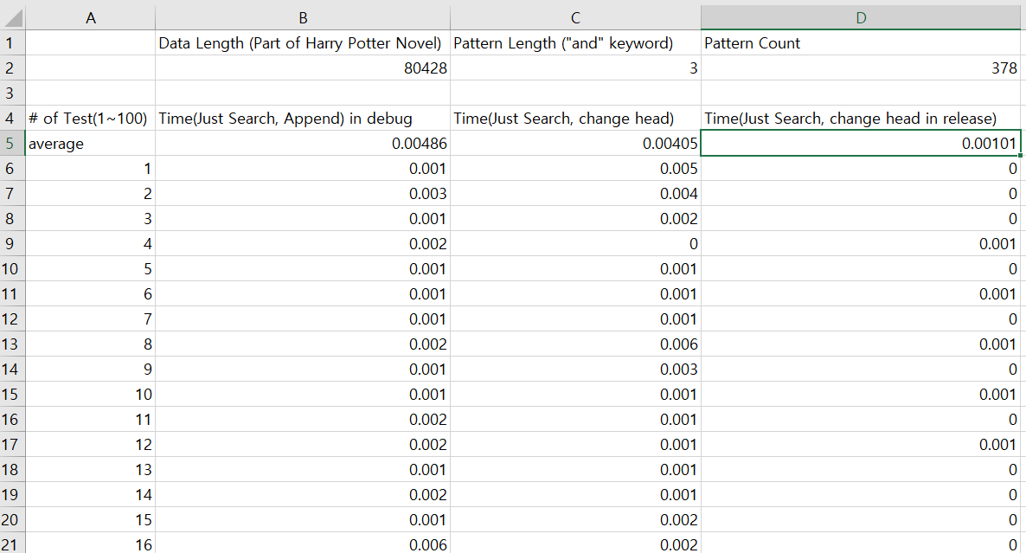
Is it really possible? (Scale Issue)
Toy Test
The length of time it takes to simply find?
(The decimal precision is up to the fifth decimal place.)
0.00405 (in Debug)
0.00101 (in Release)

Slide 10
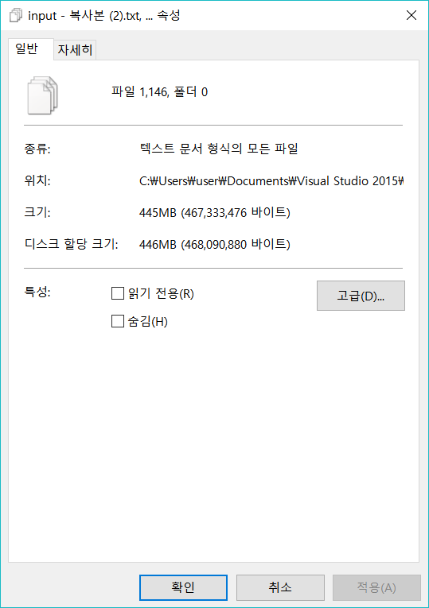
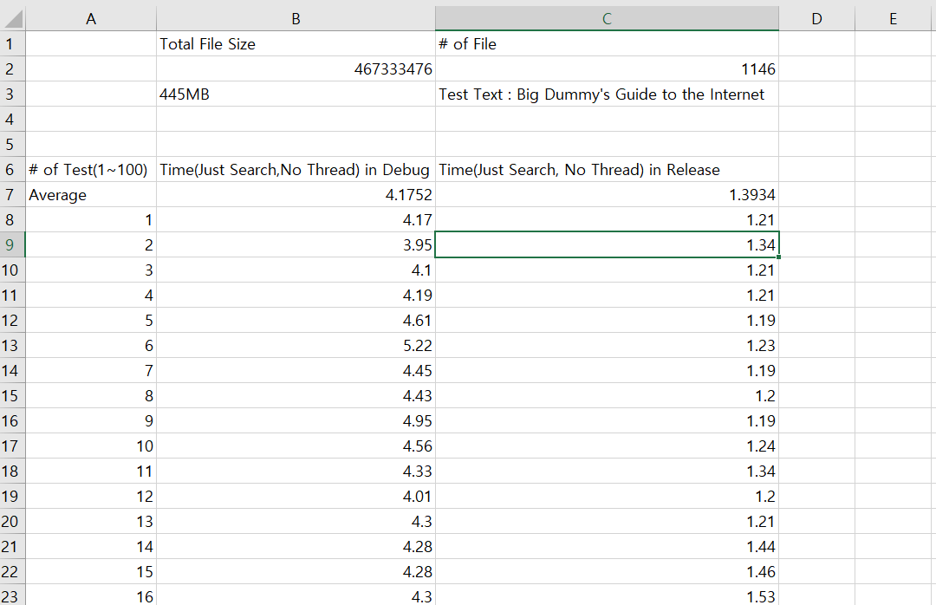
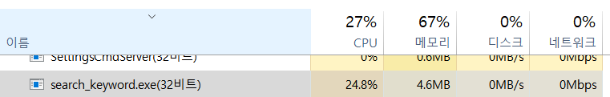
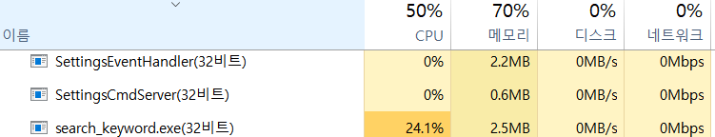
Is it really possible? (Scale Issue)
Loop 1~100
Debug
Release

Slide 11
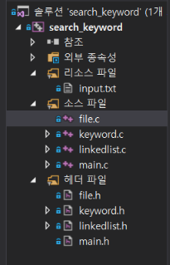
Source & Header File
Linkedlist : LinkedList structure, function
To do : sort list
Keyword : find keyword in document
To do : rank in document
File : Todo : get File list in directory
Todo : Distribute File list to Thread( If # of File > 1000)
Main : process argument
As of 10/28
As of 10/29

